Slide 1
W03 Assignment MDSC 689.03
Matt Daalder
2020

Slide 2
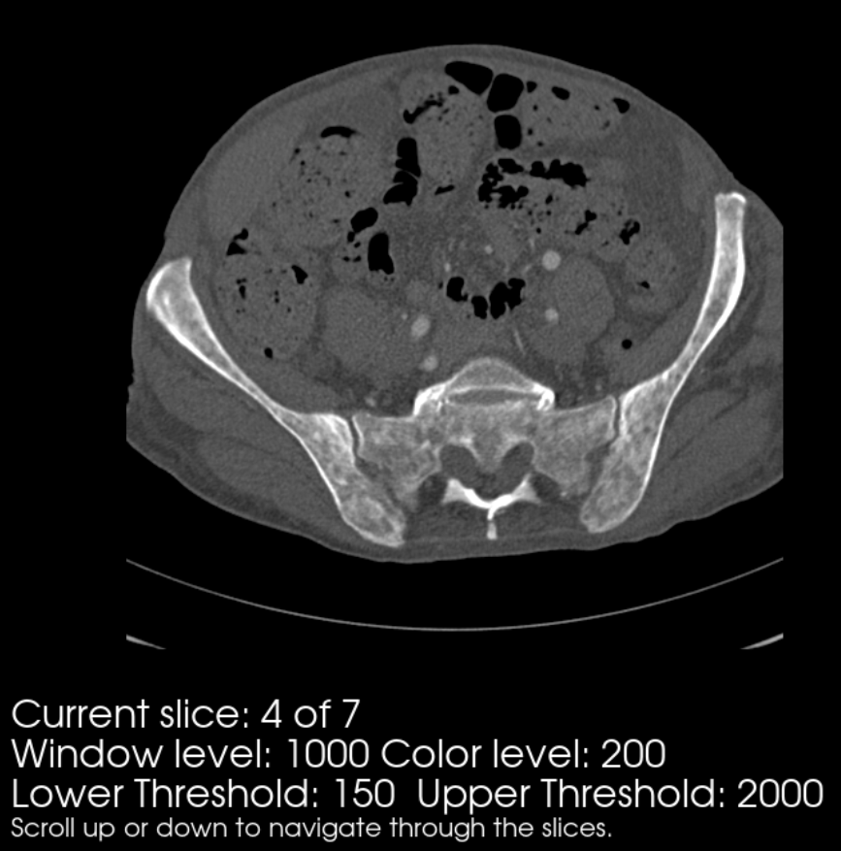
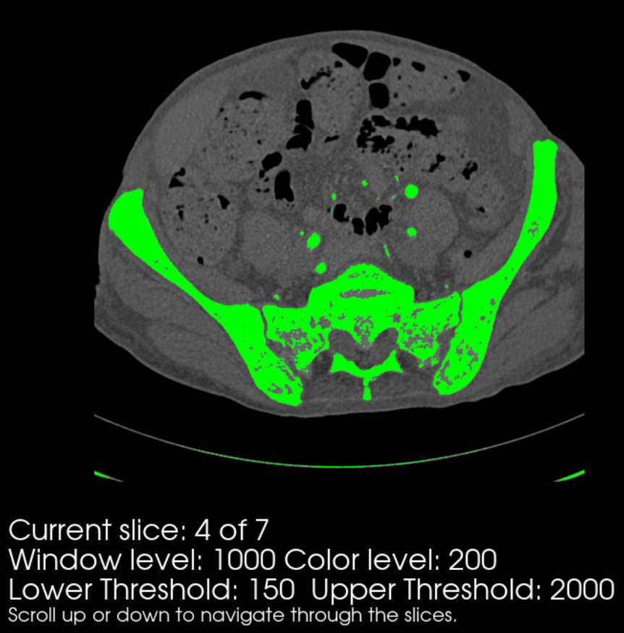
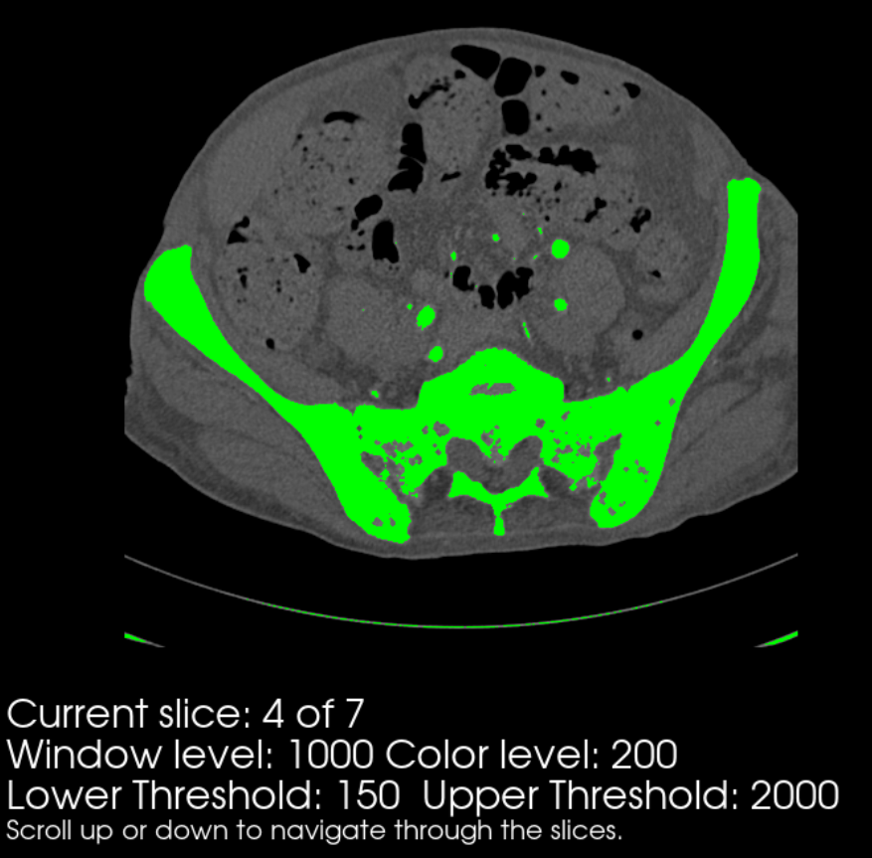
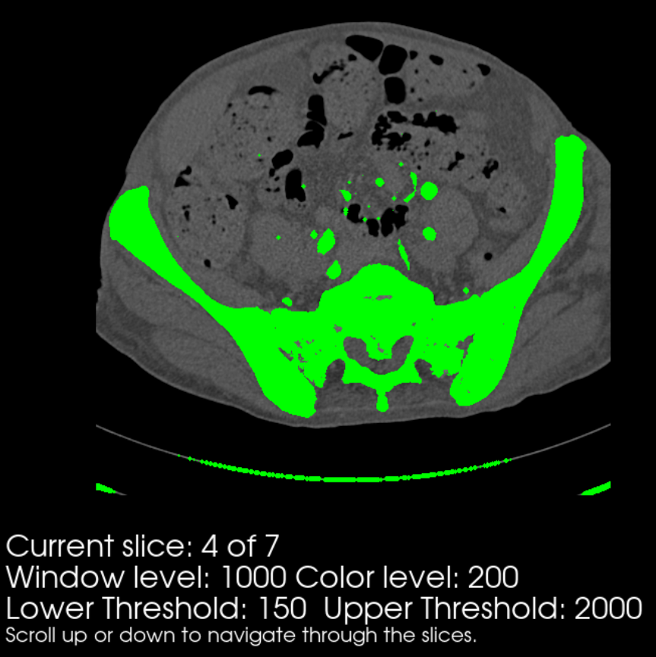
Hip DICOM slice 167 shown
In clockwise order, from top left:
the hip in original format*
the hip with mostly bone segmented
Two dilation iterations completed
Two erosion iterations completed on iii) to perform a closing function
* No smoothing filter was applied

Slide 3
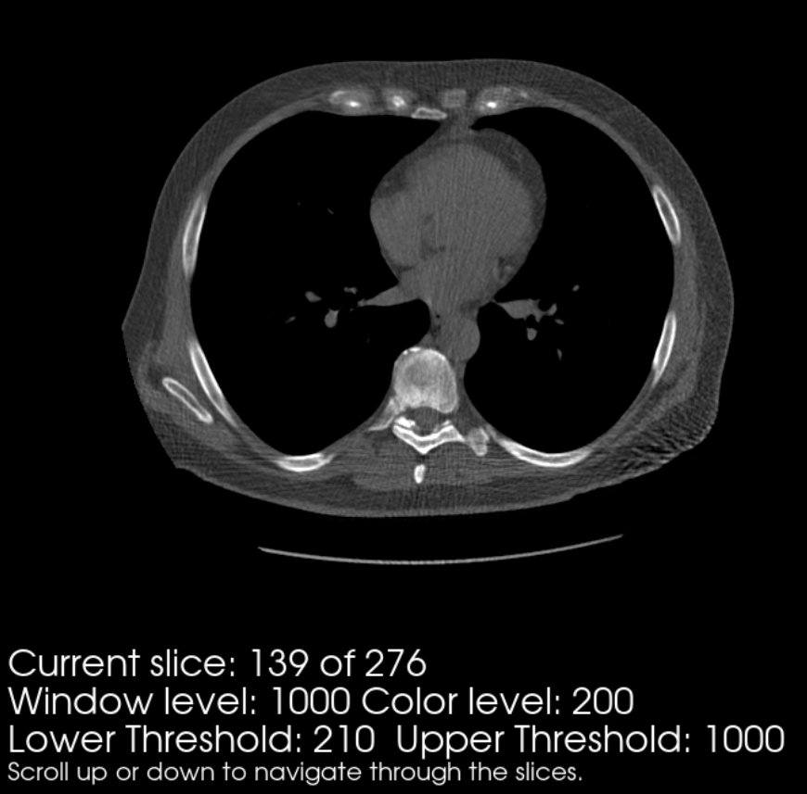
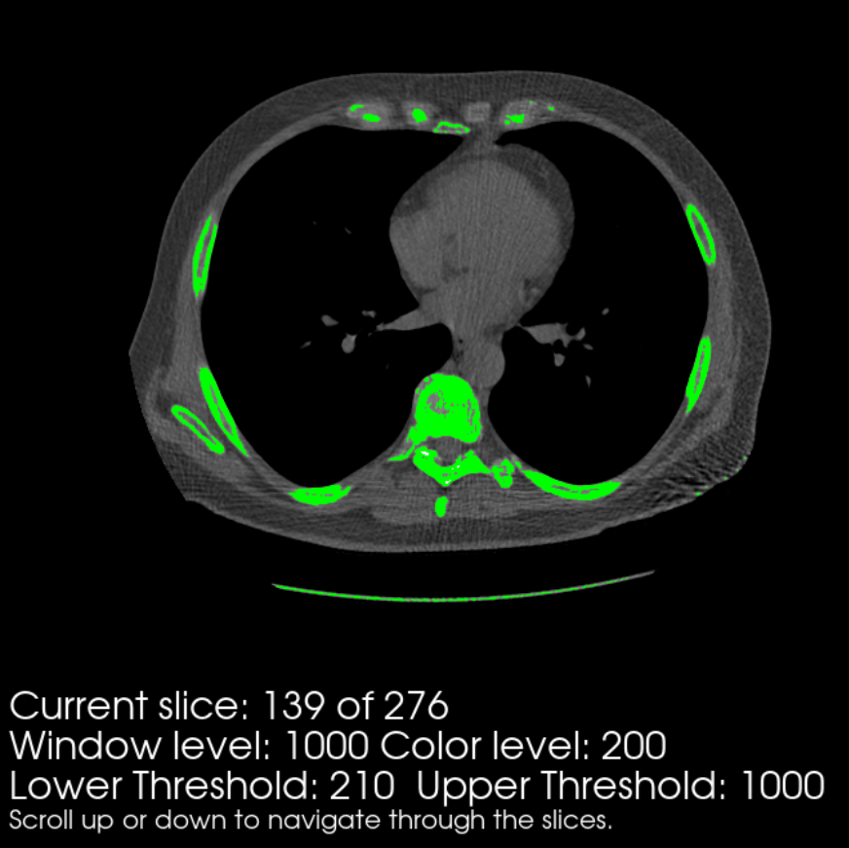
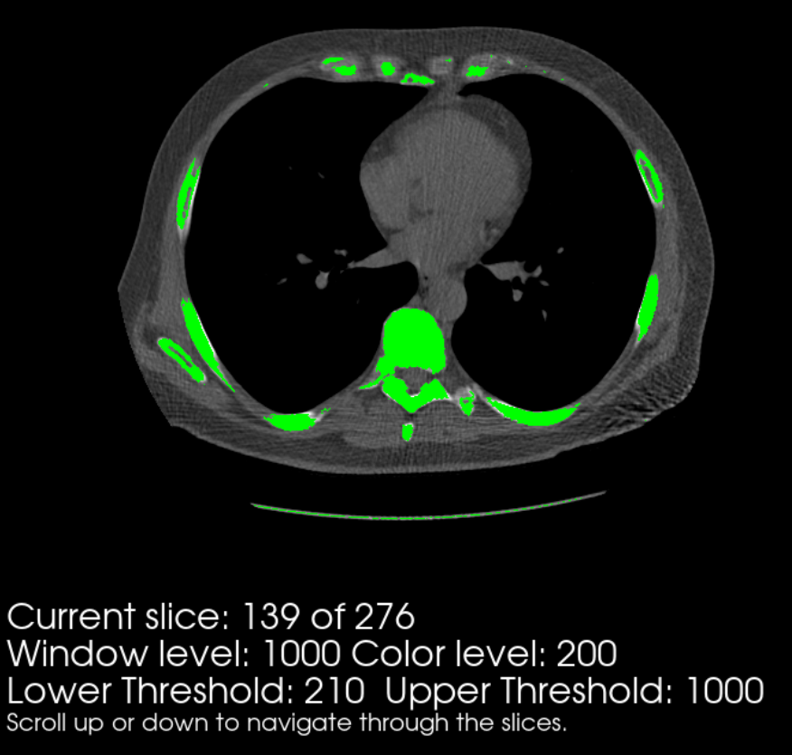
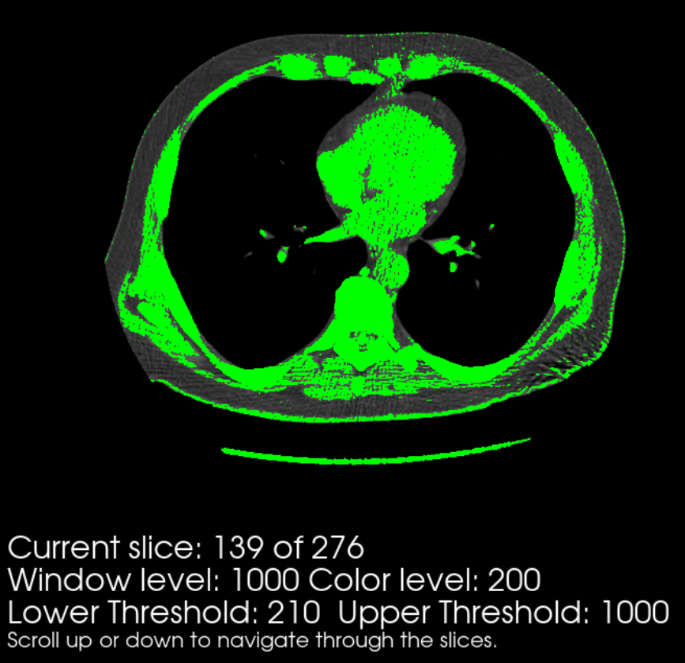
Thorax DICOM slice 139 shown
In clockwise order, from top left:
the thorax in original format*
the thorax with mostly bone segmented
Two dilation iterations completed
Two erosion iterations completed on iii) to perform a closing function
* Gaussian filtering was required to produce an image without significant noise

Slide 4
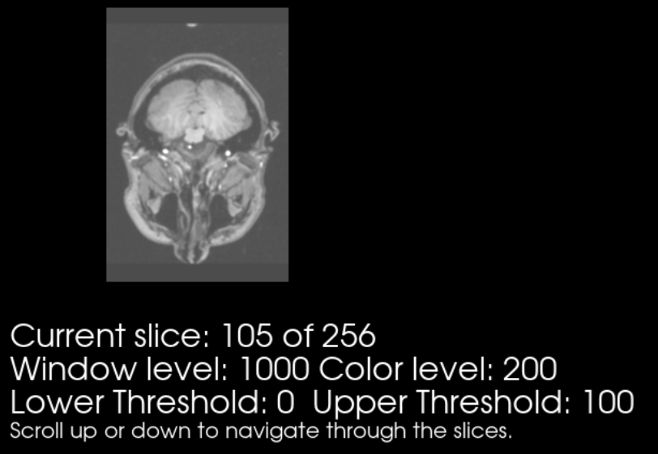
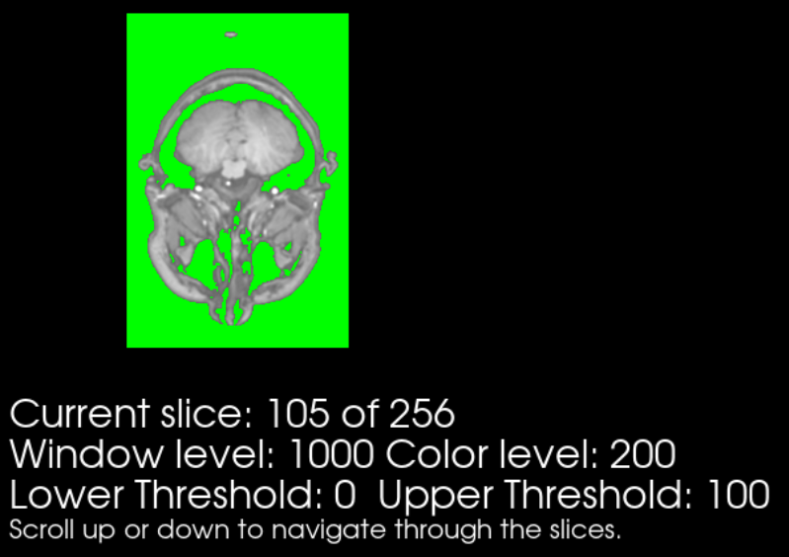
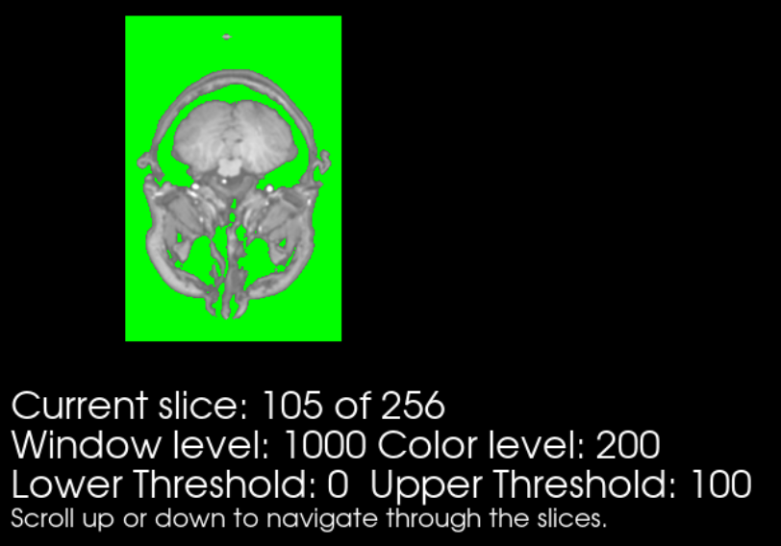
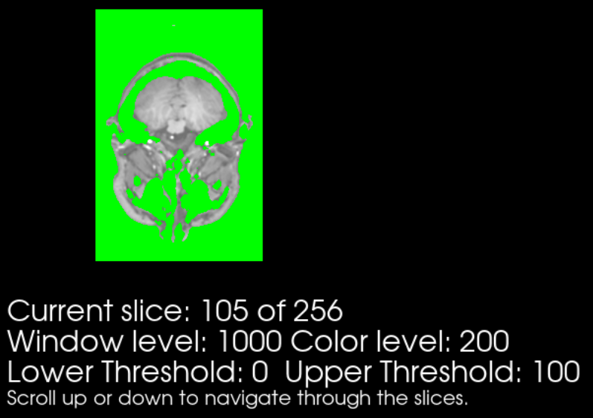
Head NIFTI slice 105 shown
In clockwise order, from top left:
the head in original format*
the head with mostly air and some liquid segmented
Two dilation iterations completed
Two erosion iterations completed on iii) to perform a closing function
* Gaussian filtering was applied

